Slide 1
BIIT Financial Aid Allocation Tool
Team Members:
2020-Arid-3677 (M. Abdul Islam Ghani)
2020-Arid-3690 (M. Amir Shahzad)
2020-Arid-3699 (Muhammad Bashir)
2020-Arid-4236 (Usman Akbar)

Slide 2
Flutter Screen’s

Slide 3
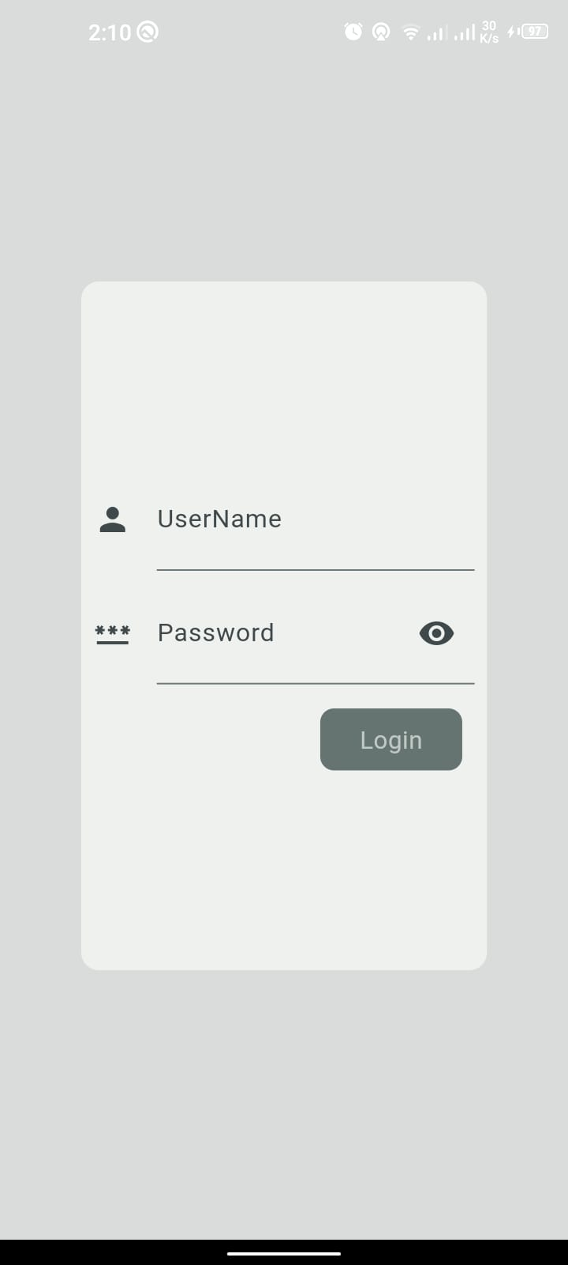
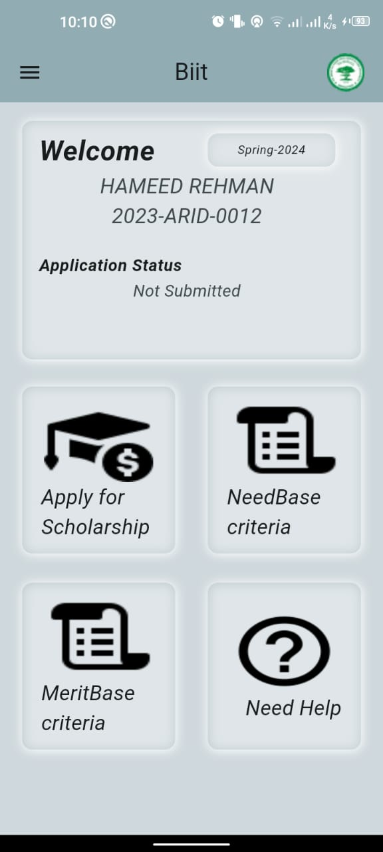
Login
Students Dashboard

Slide 4
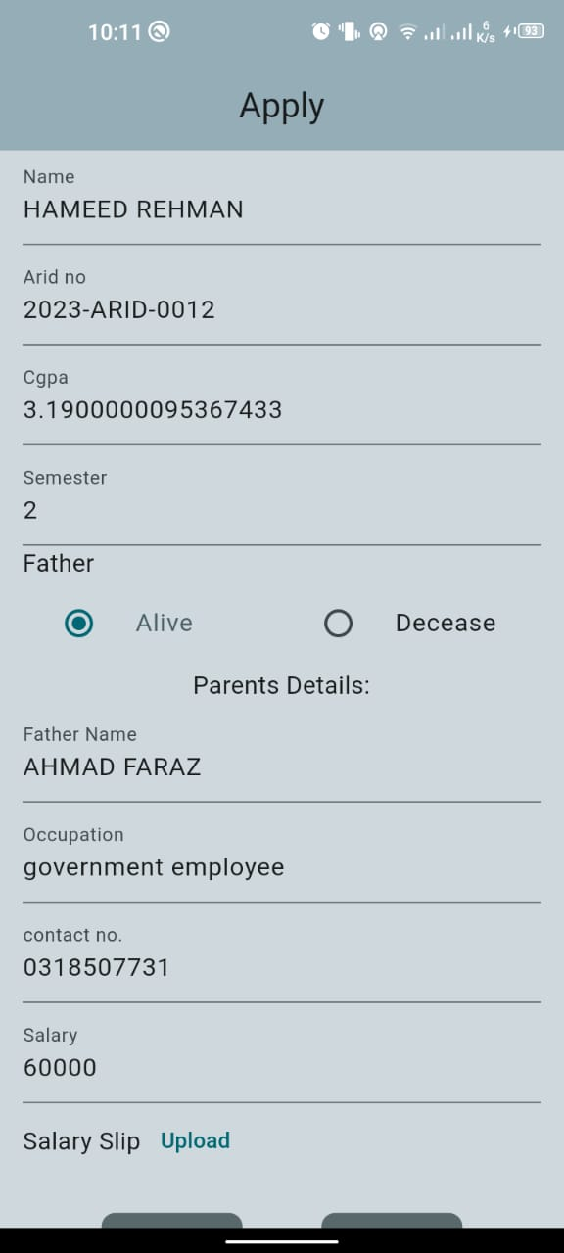
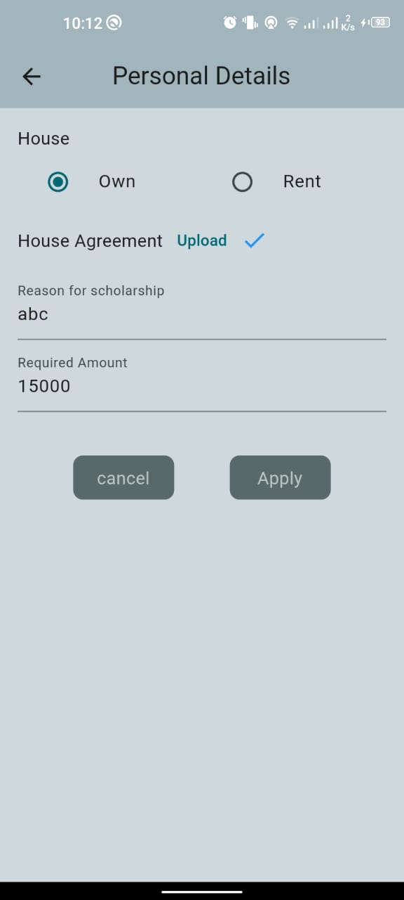
Application Form

Slide 5

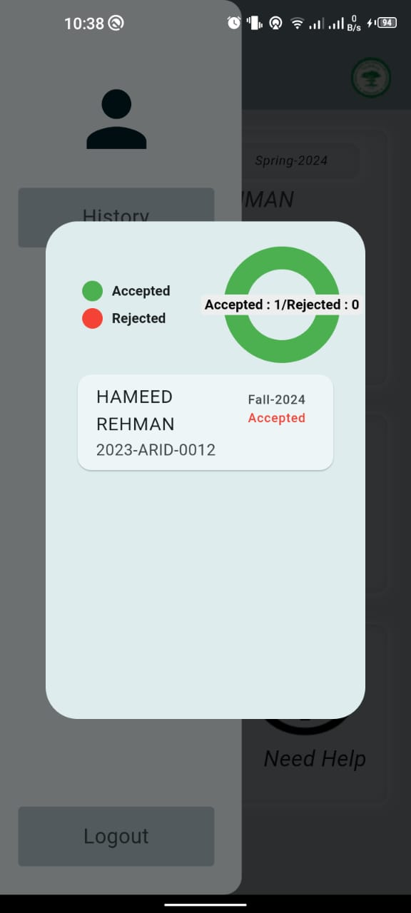
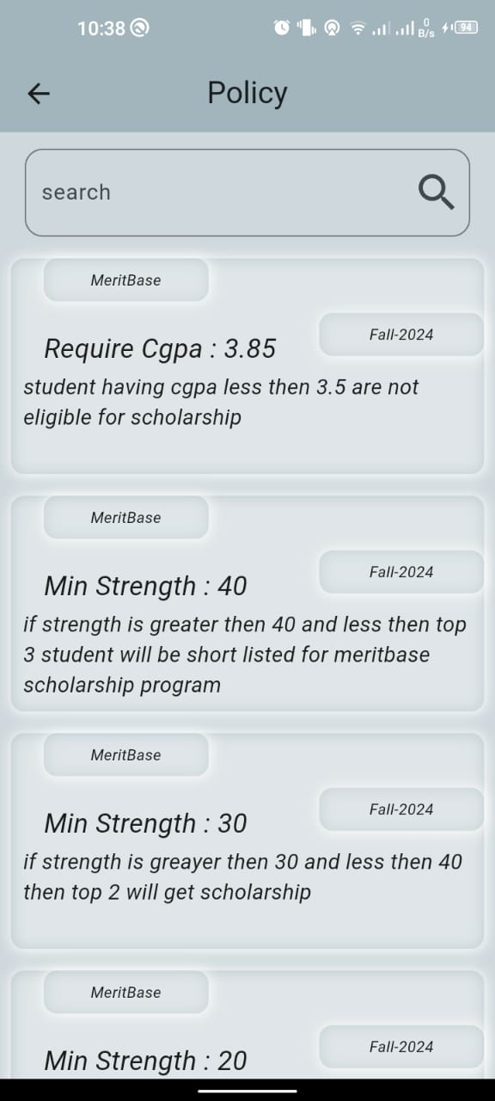
Application Status
History of Application
Policies

Slide 6
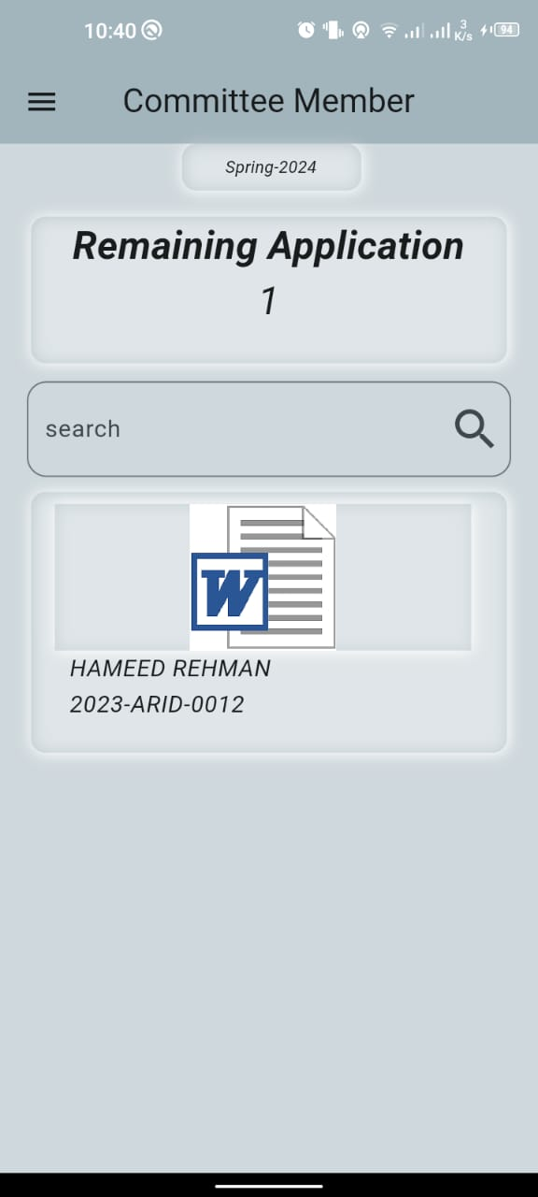
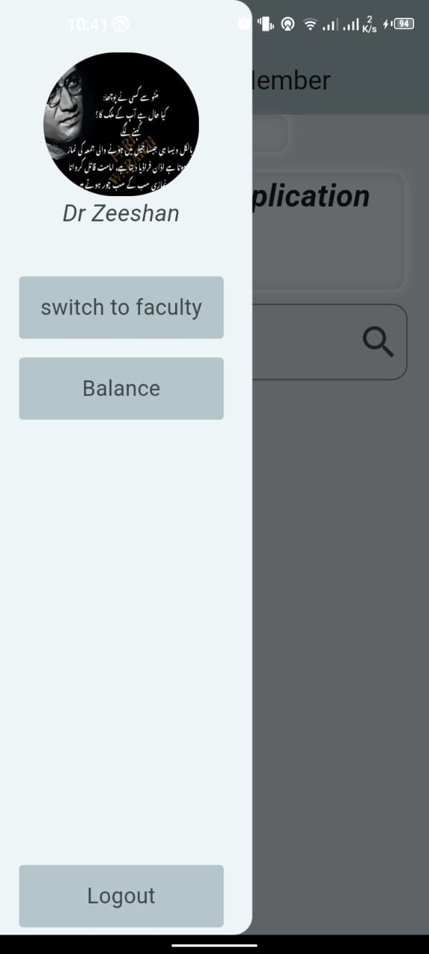
Committee Dashboard

Slide 7
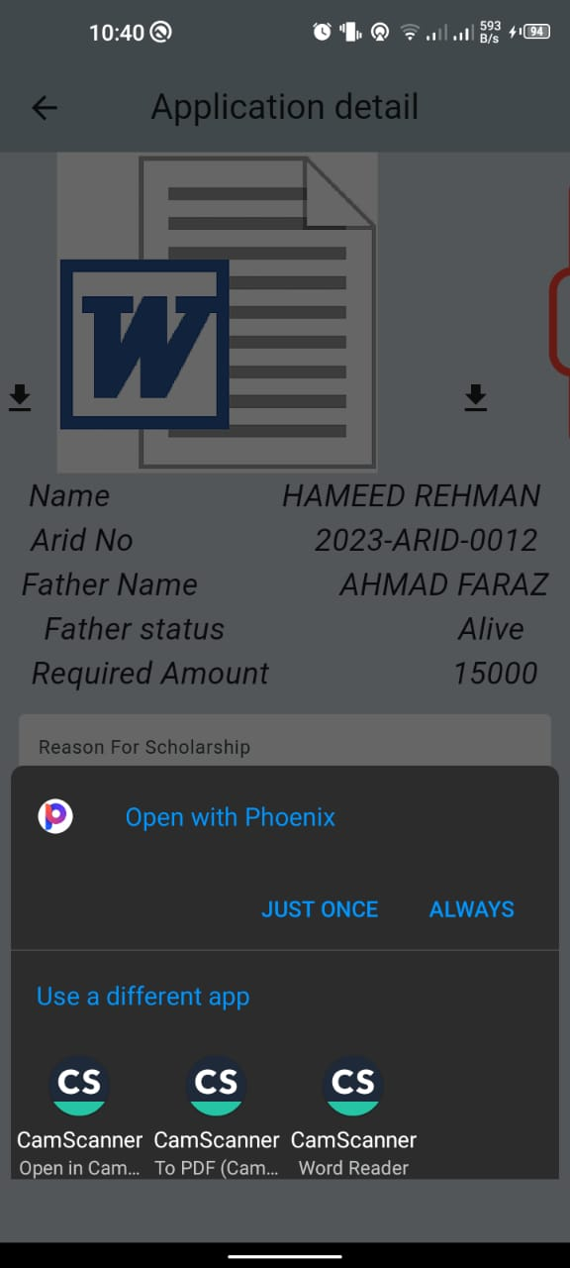
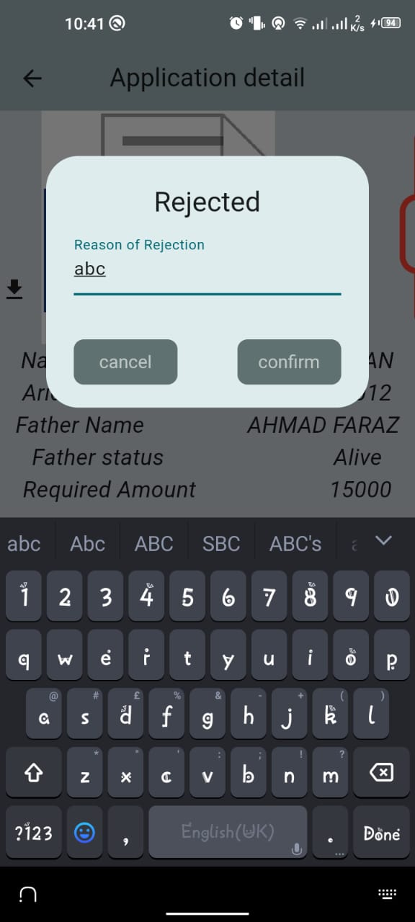
Application Details
Accepting/Rejecting Application

Slide 8
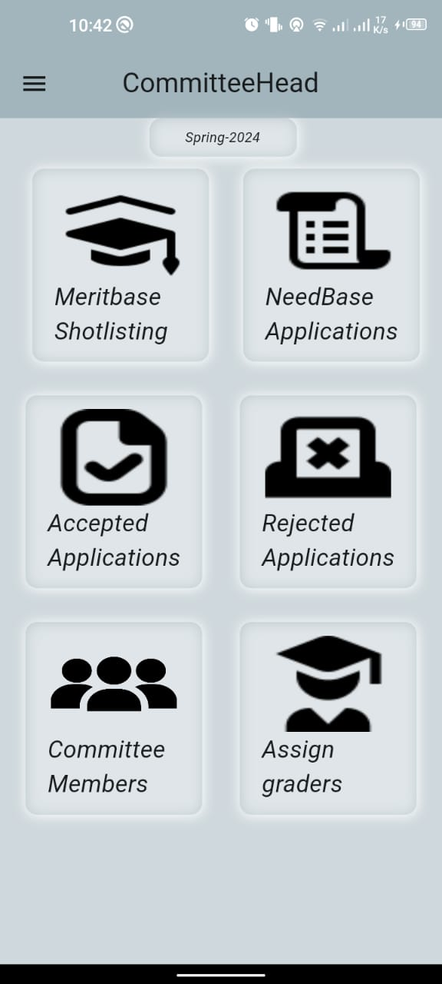
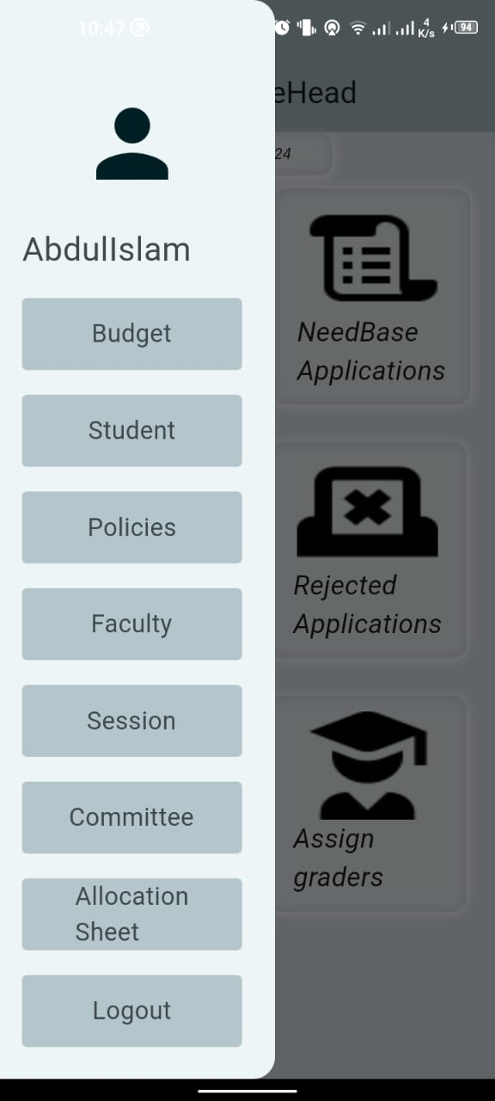
Committee Head Dashboard

Slide 9
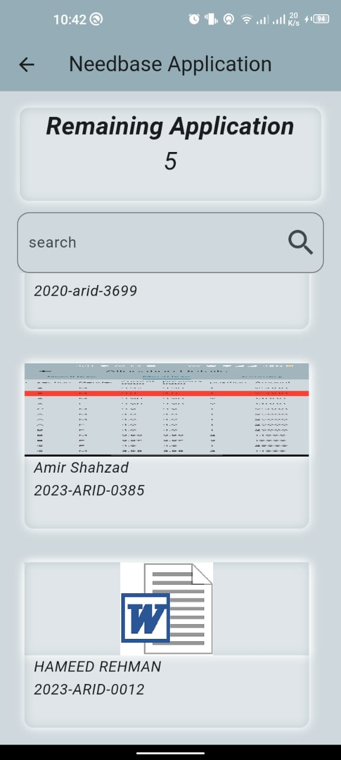
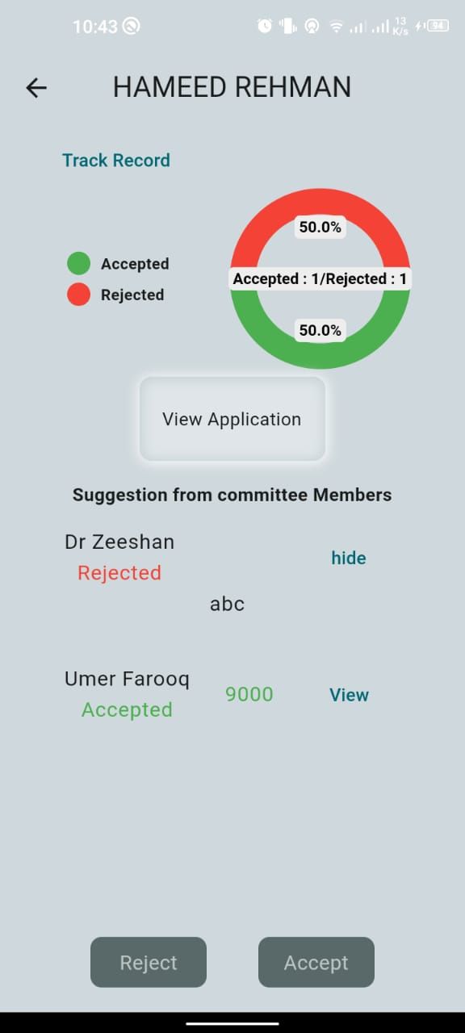
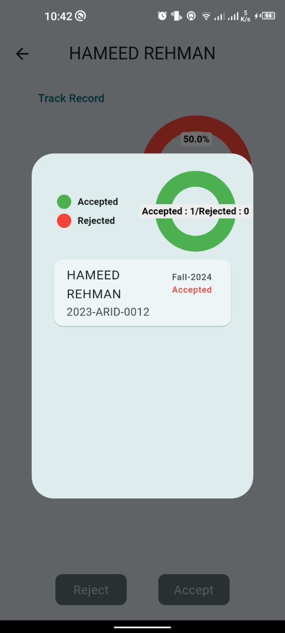
Needbase pending Application
Application Details
Track Record

Slide 10
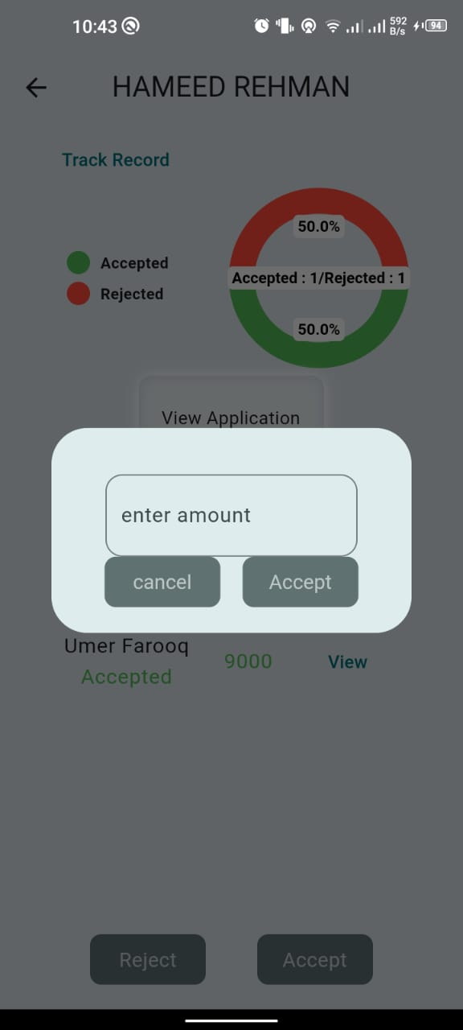
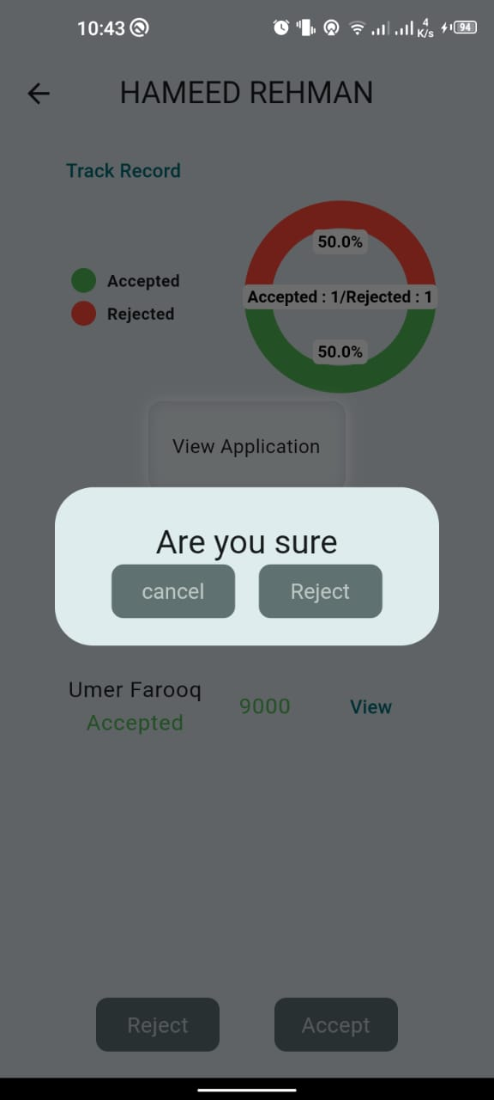
Accept Application
Reject Application

Slide 11
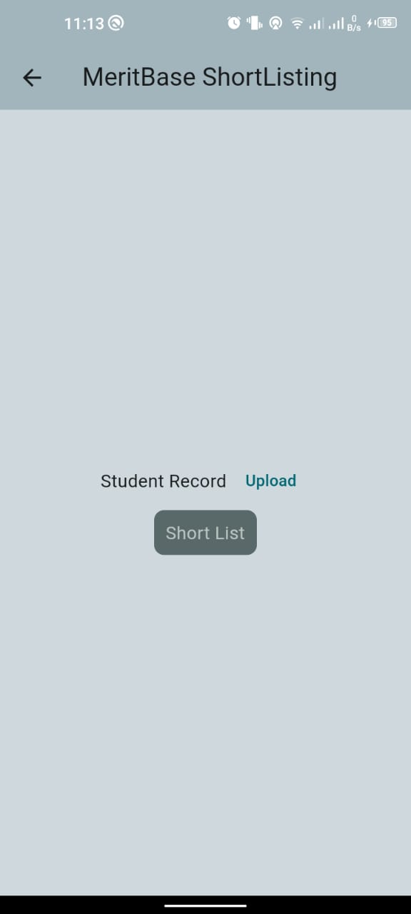
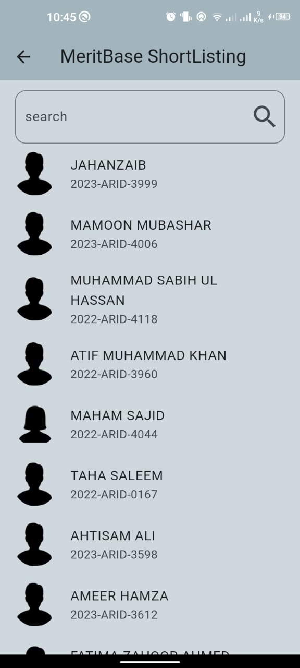
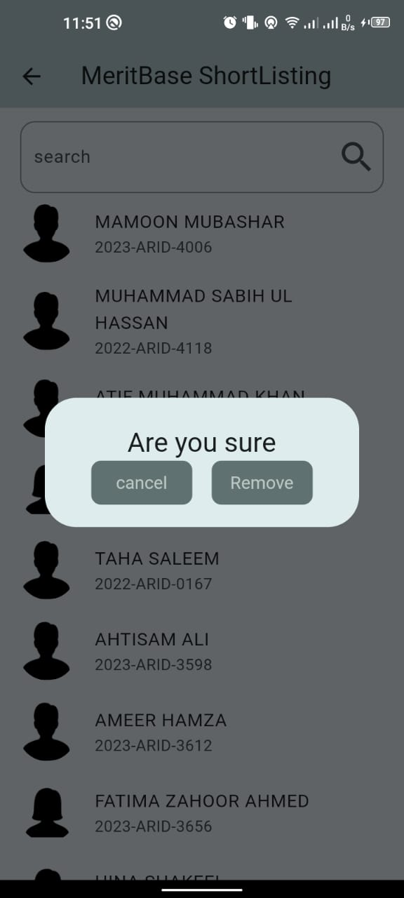
Meritbase Shortlisting
Short Listed Student
Reject Shortlisted Student

Slide 12
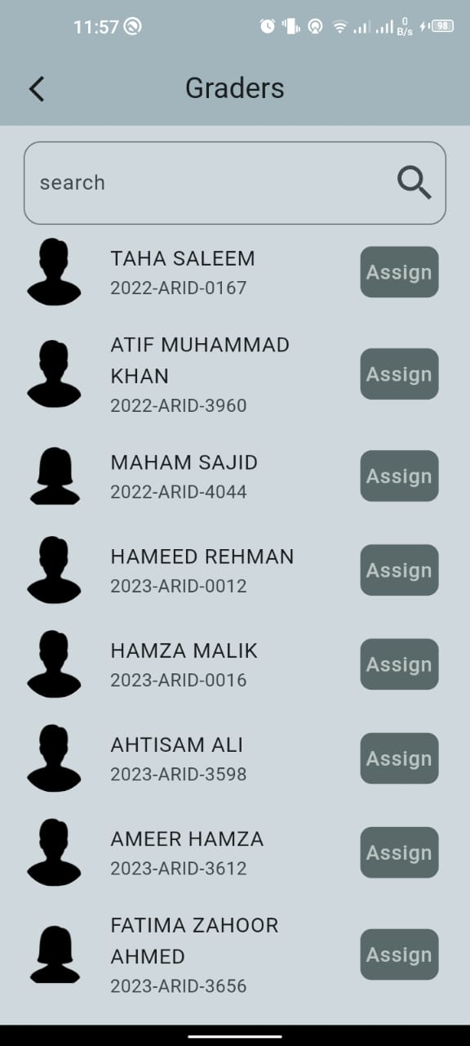
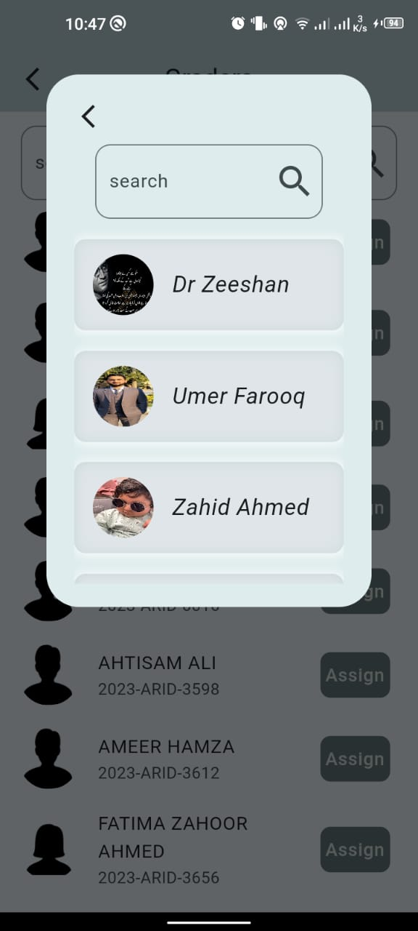
Assign Grader

Slide 13
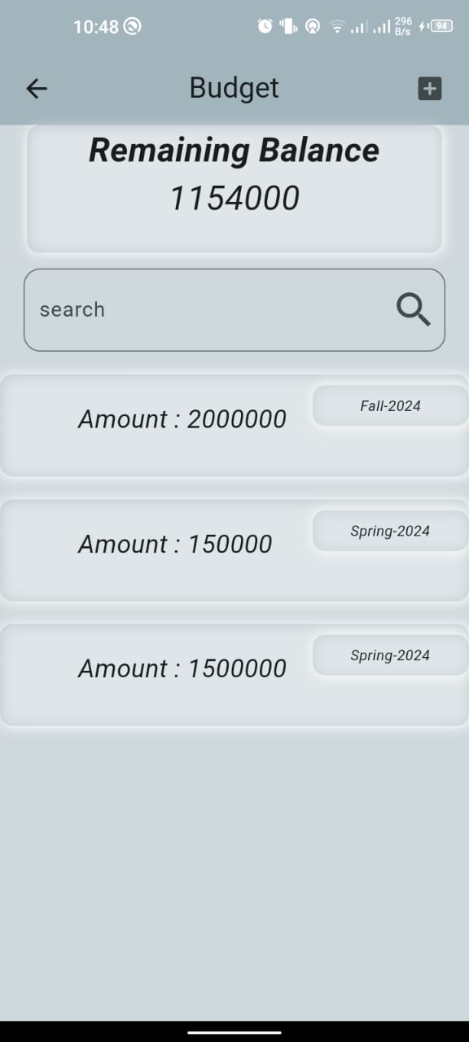
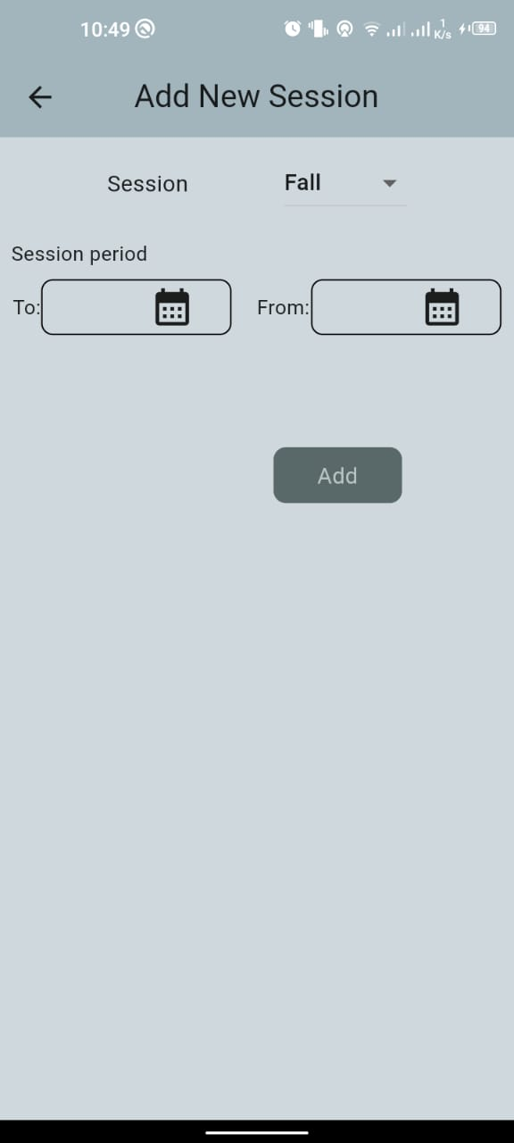
Add Budget
Add Session

Slide 14
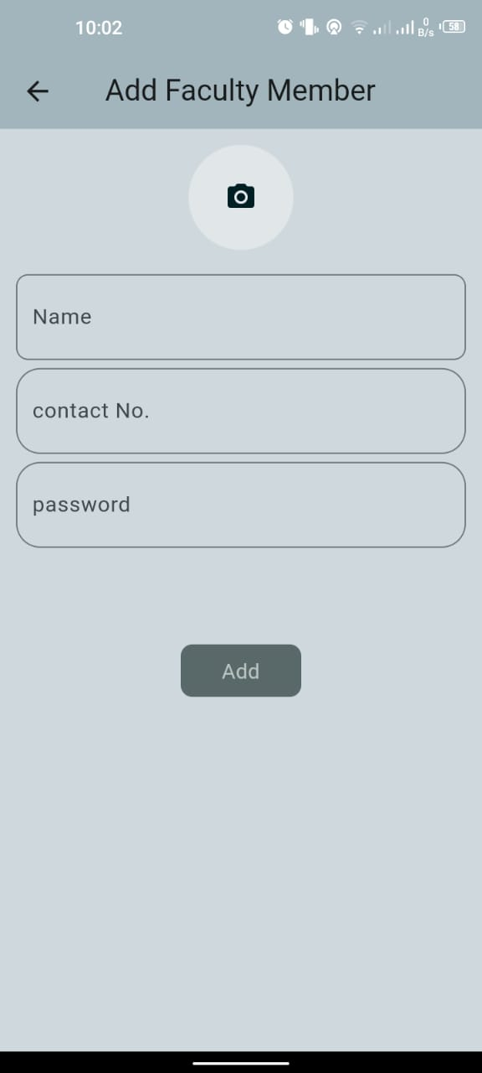
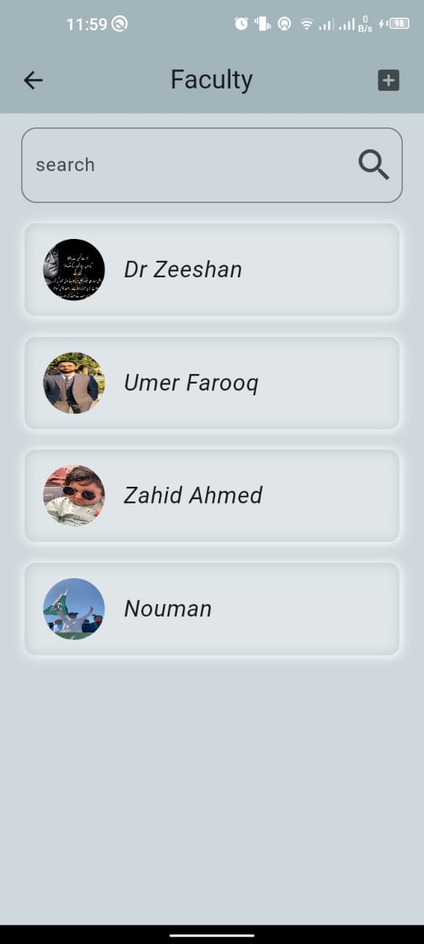
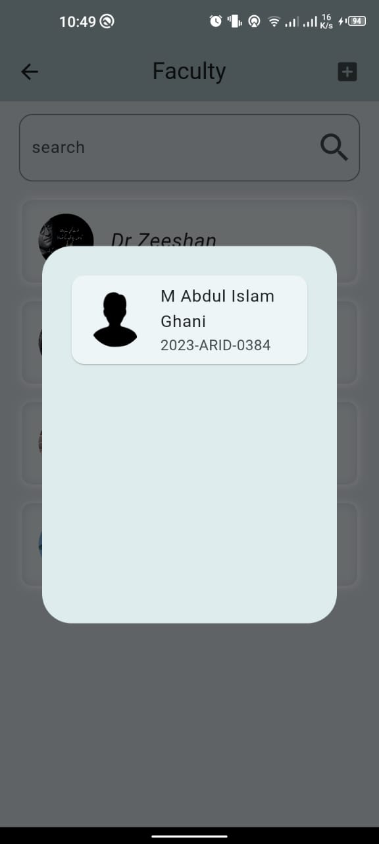
Add Faculty
Faculty Members
Grader Information of Faculty

Slide 15
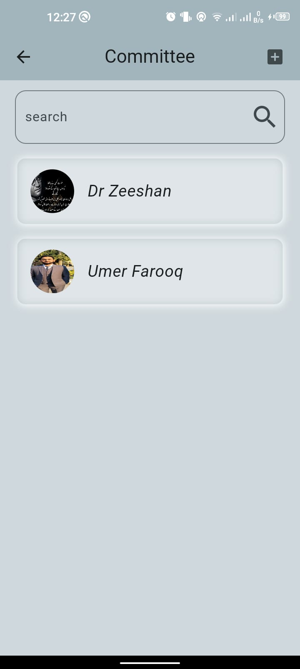
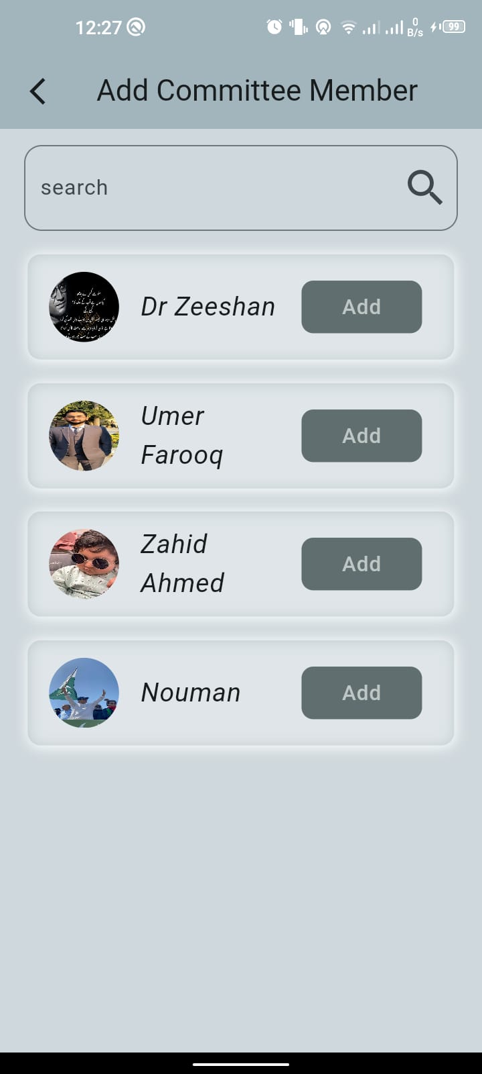
Committee Member
Add Committee Member

Slide 16
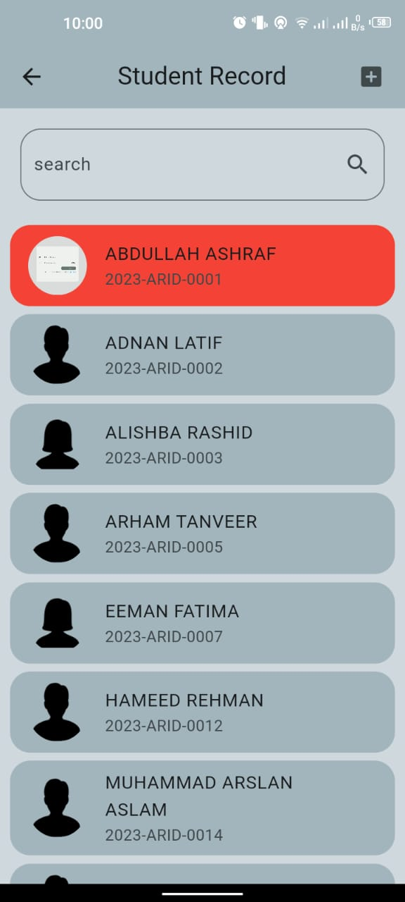
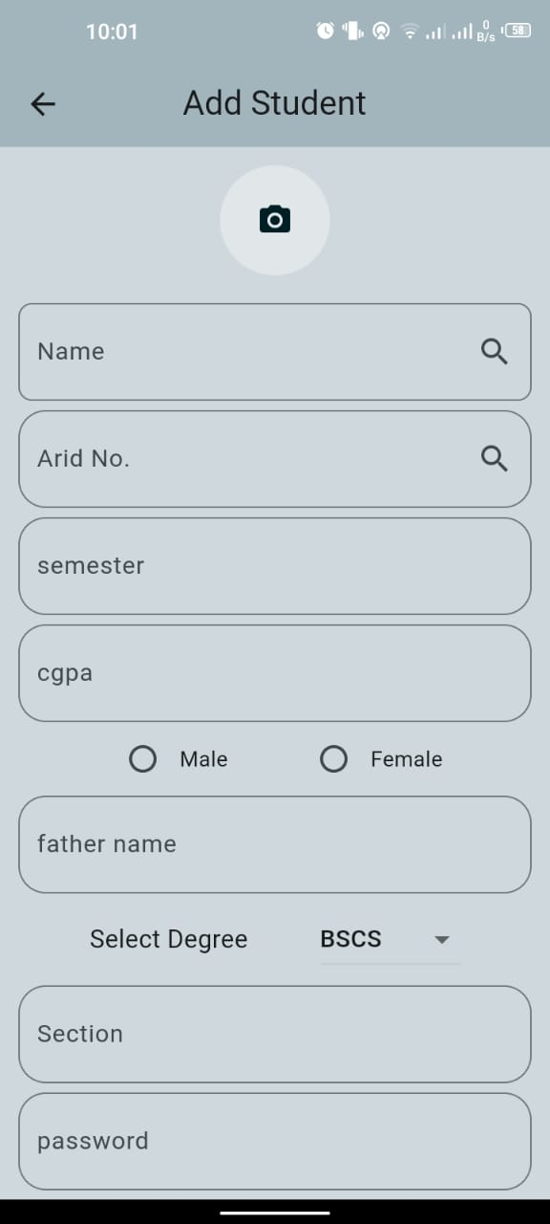
Student Record
Add Student

Slide 17
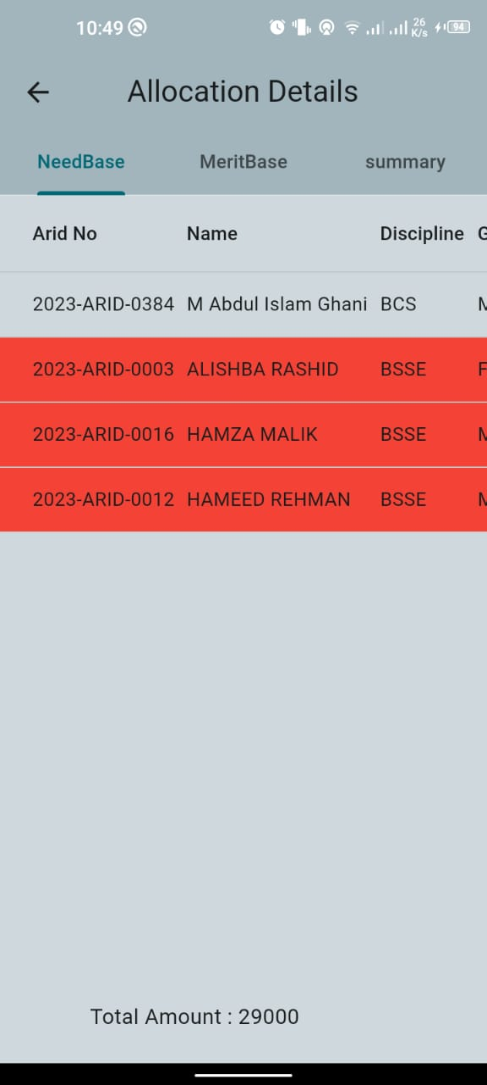
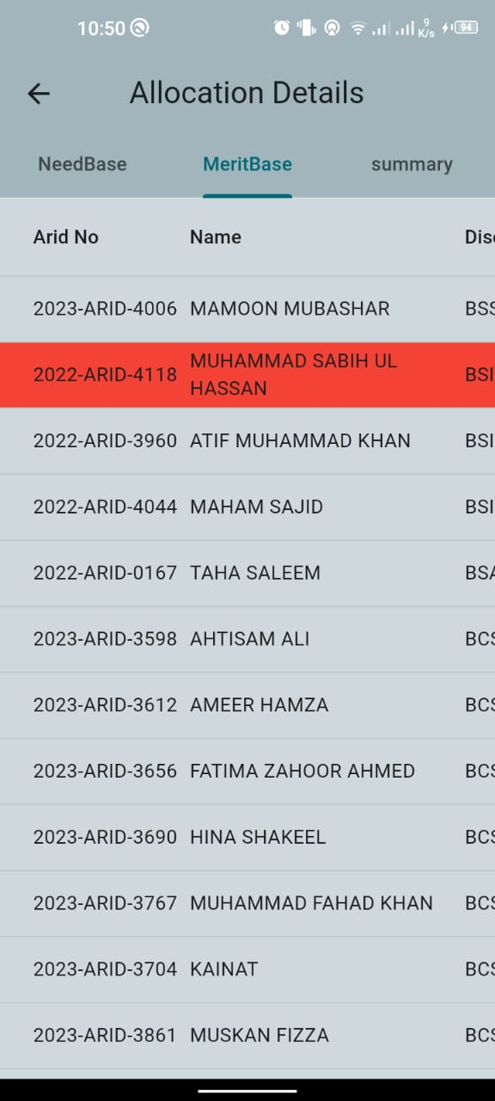
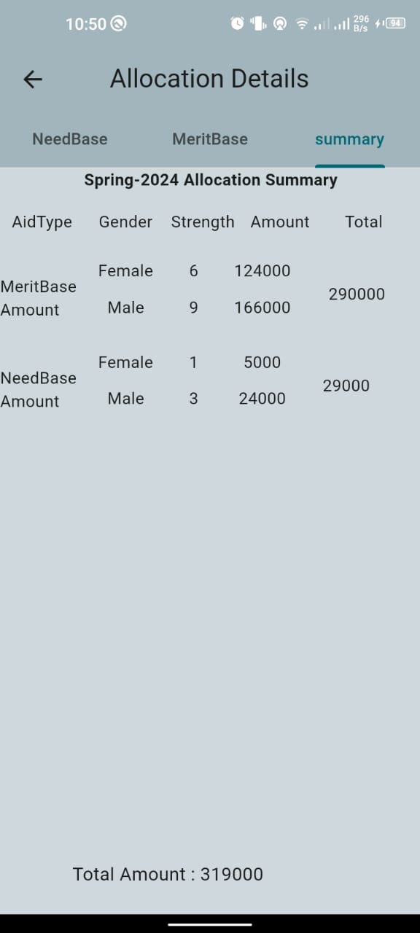
Allocation Sheet

Slide 18
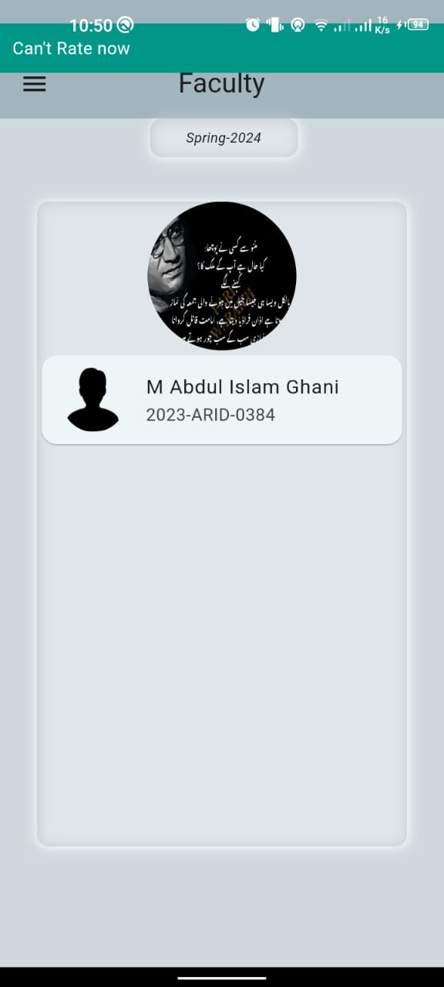
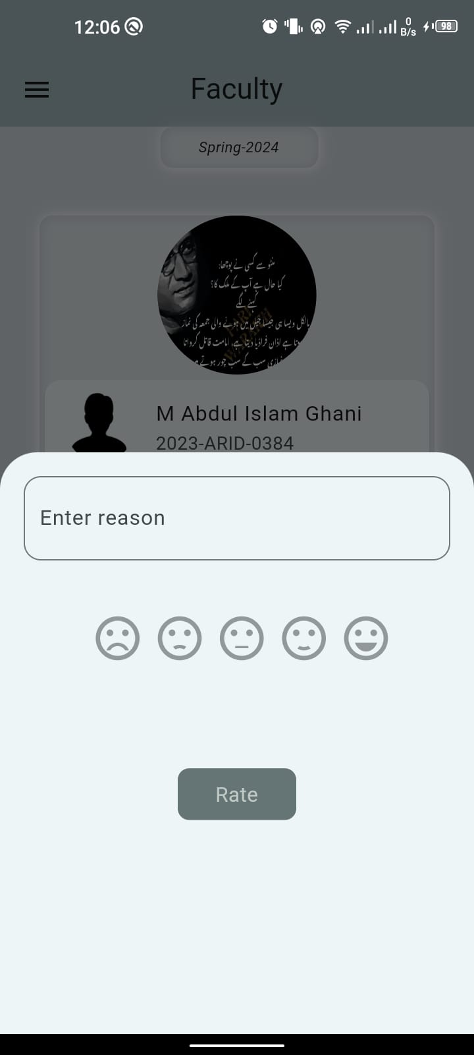
Faculty Dashboard
Rate Grader

Slide 19
React Native Screen’s

Slide 20
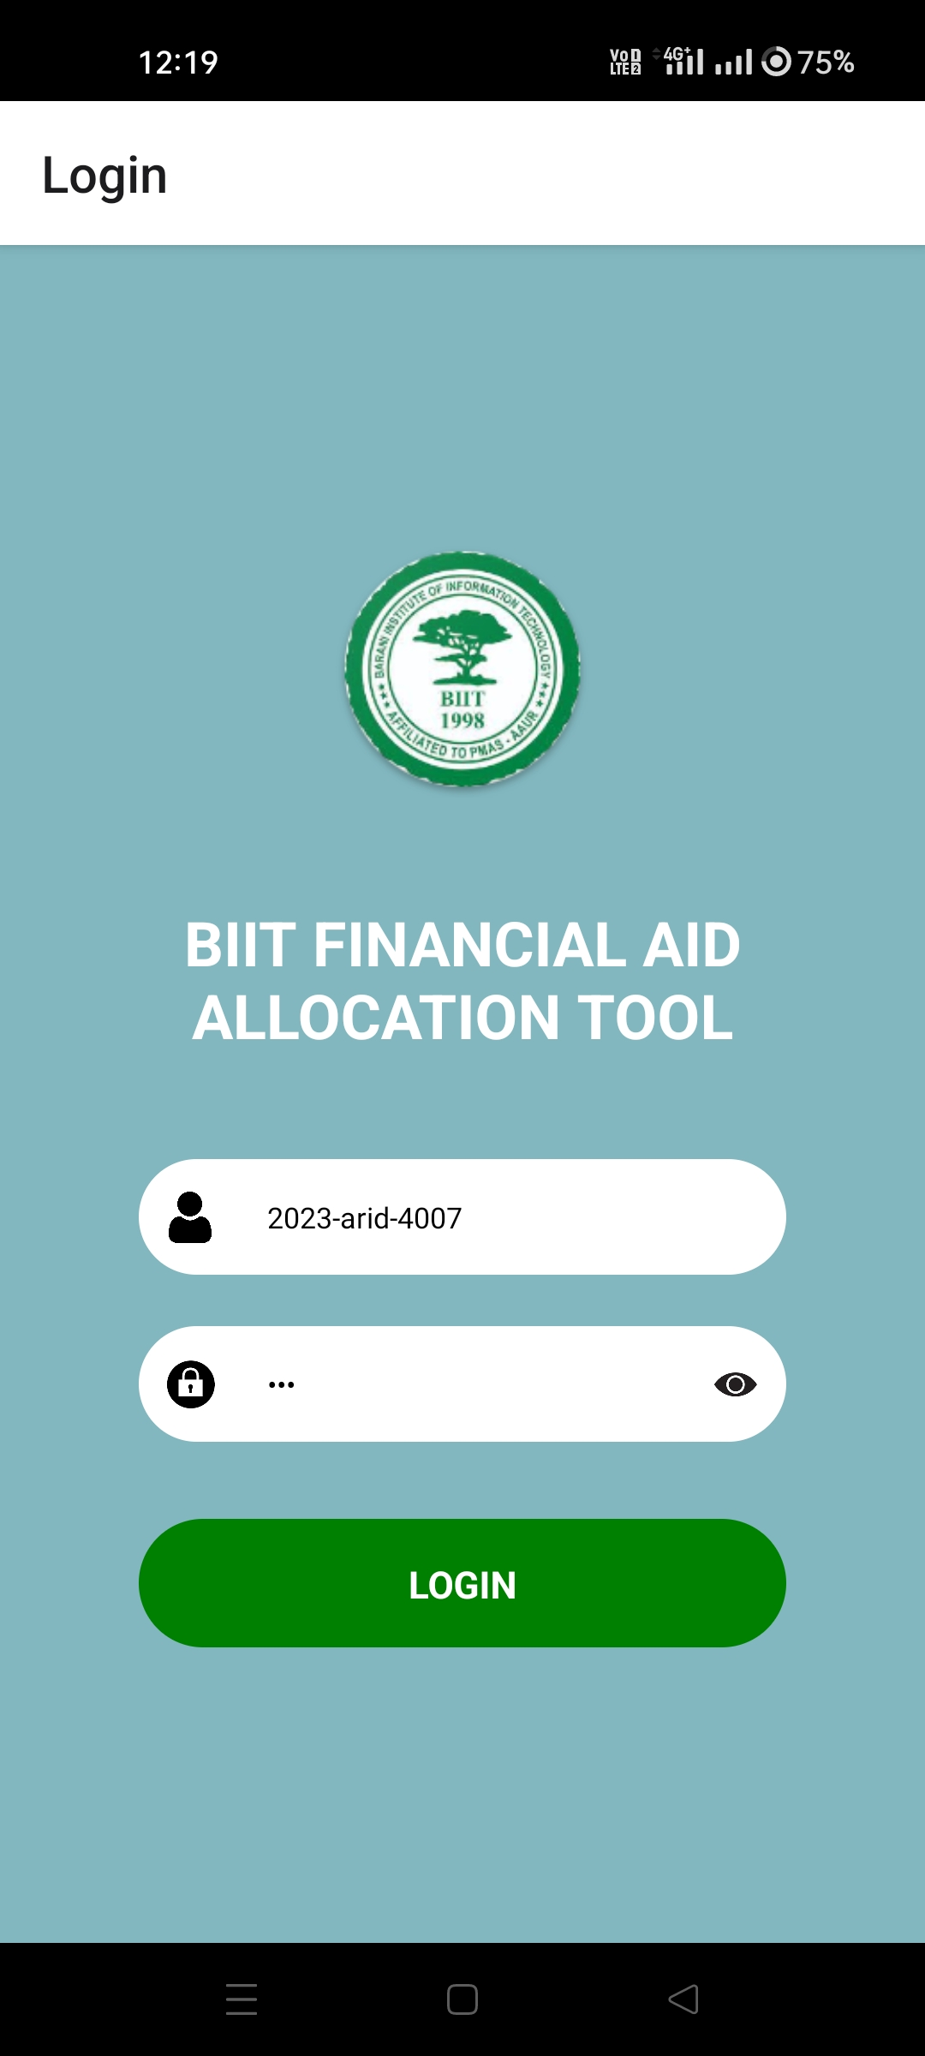
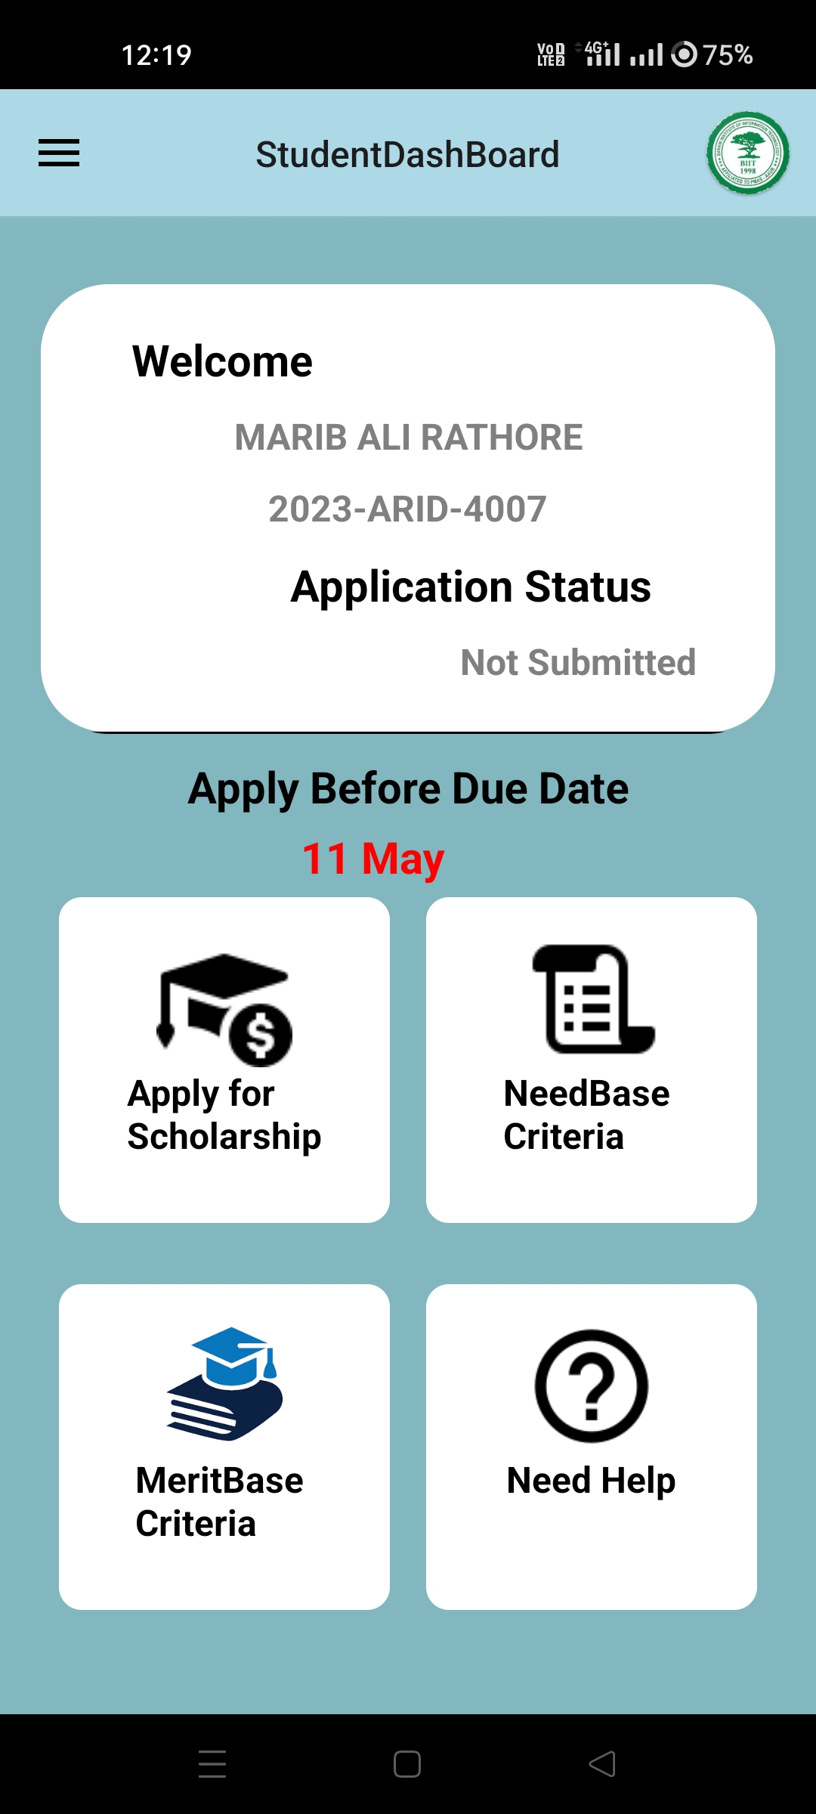
Login
Students Dashboard

Slide 21
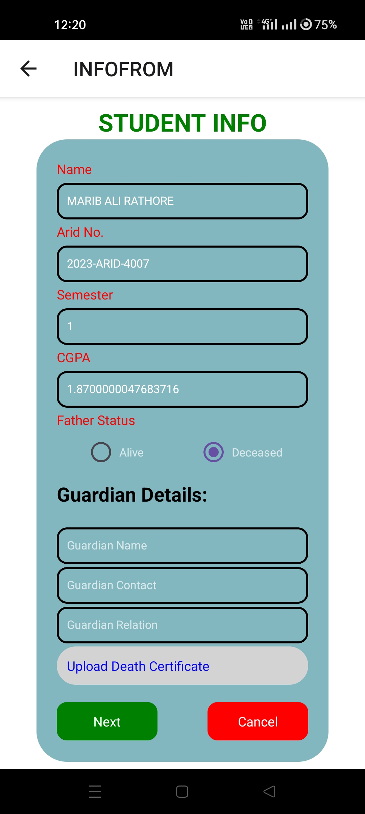
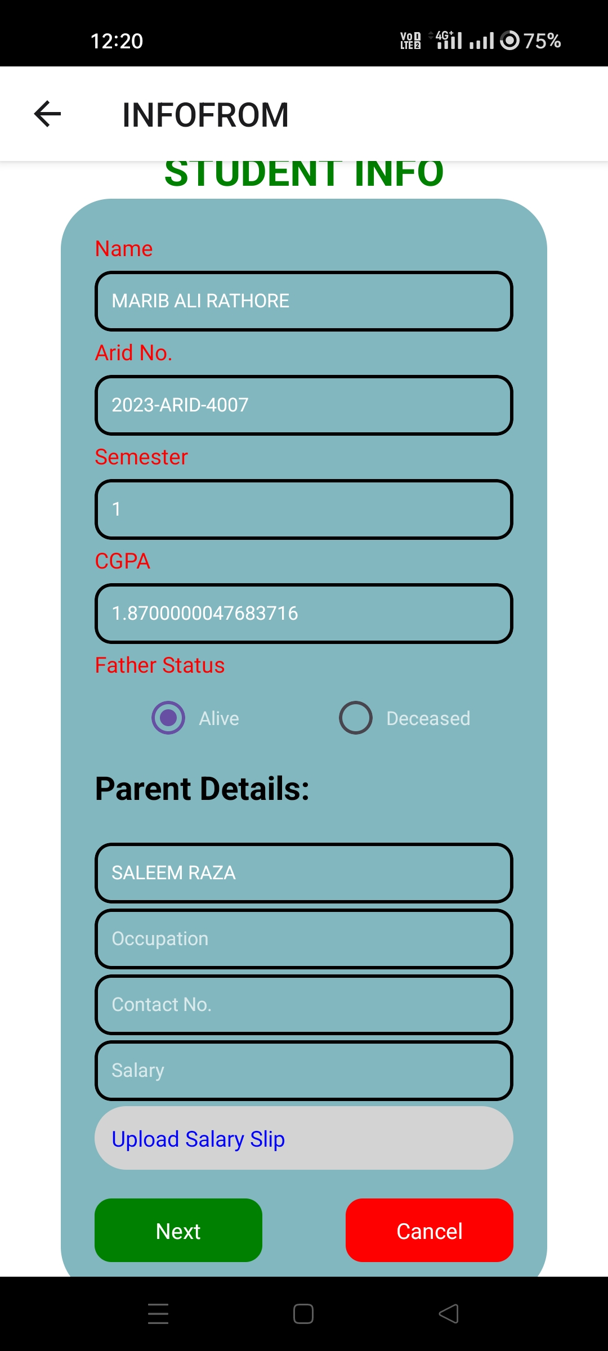
Student Information
Students Information

Slide 22
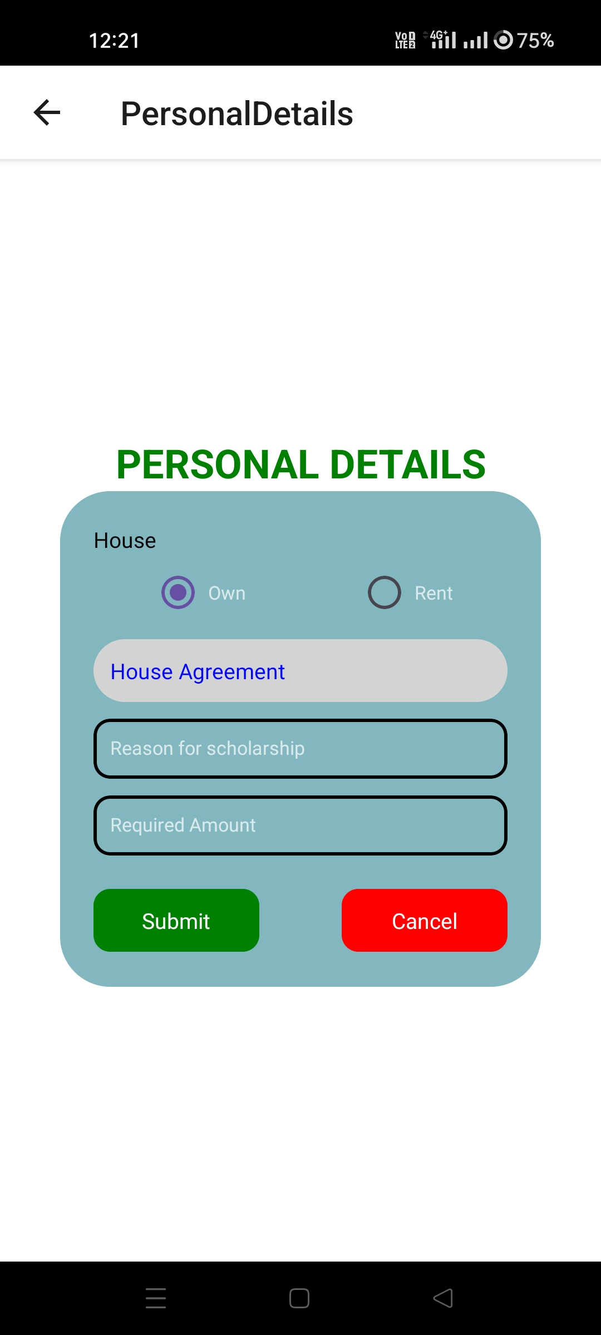
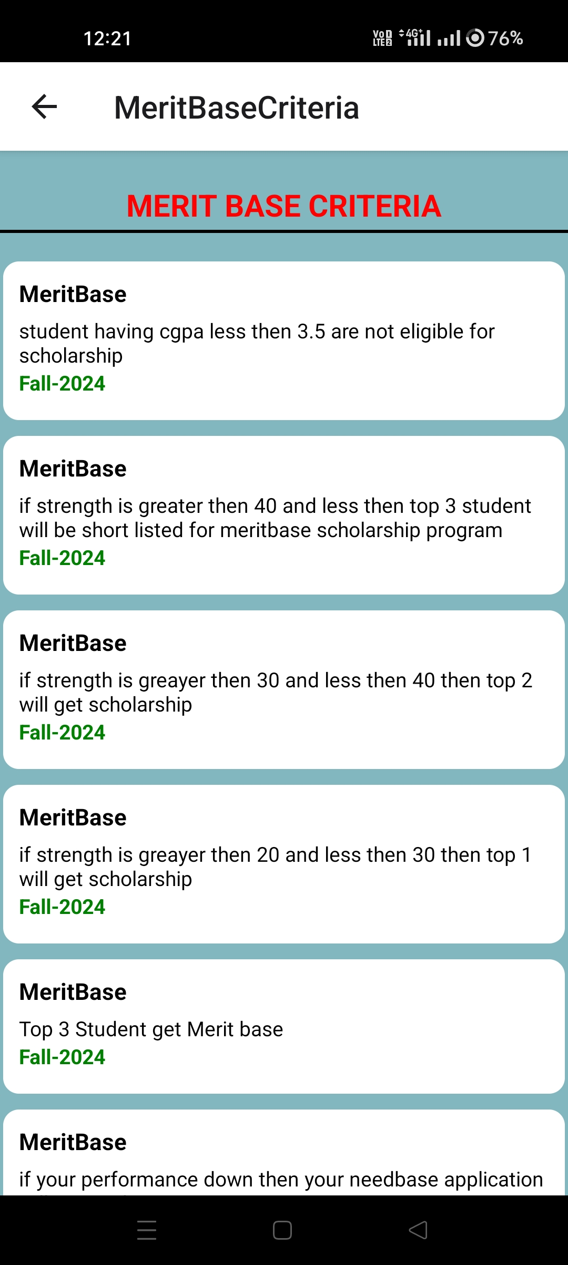
Personal Details
Merit-base Criteria

Slide 23
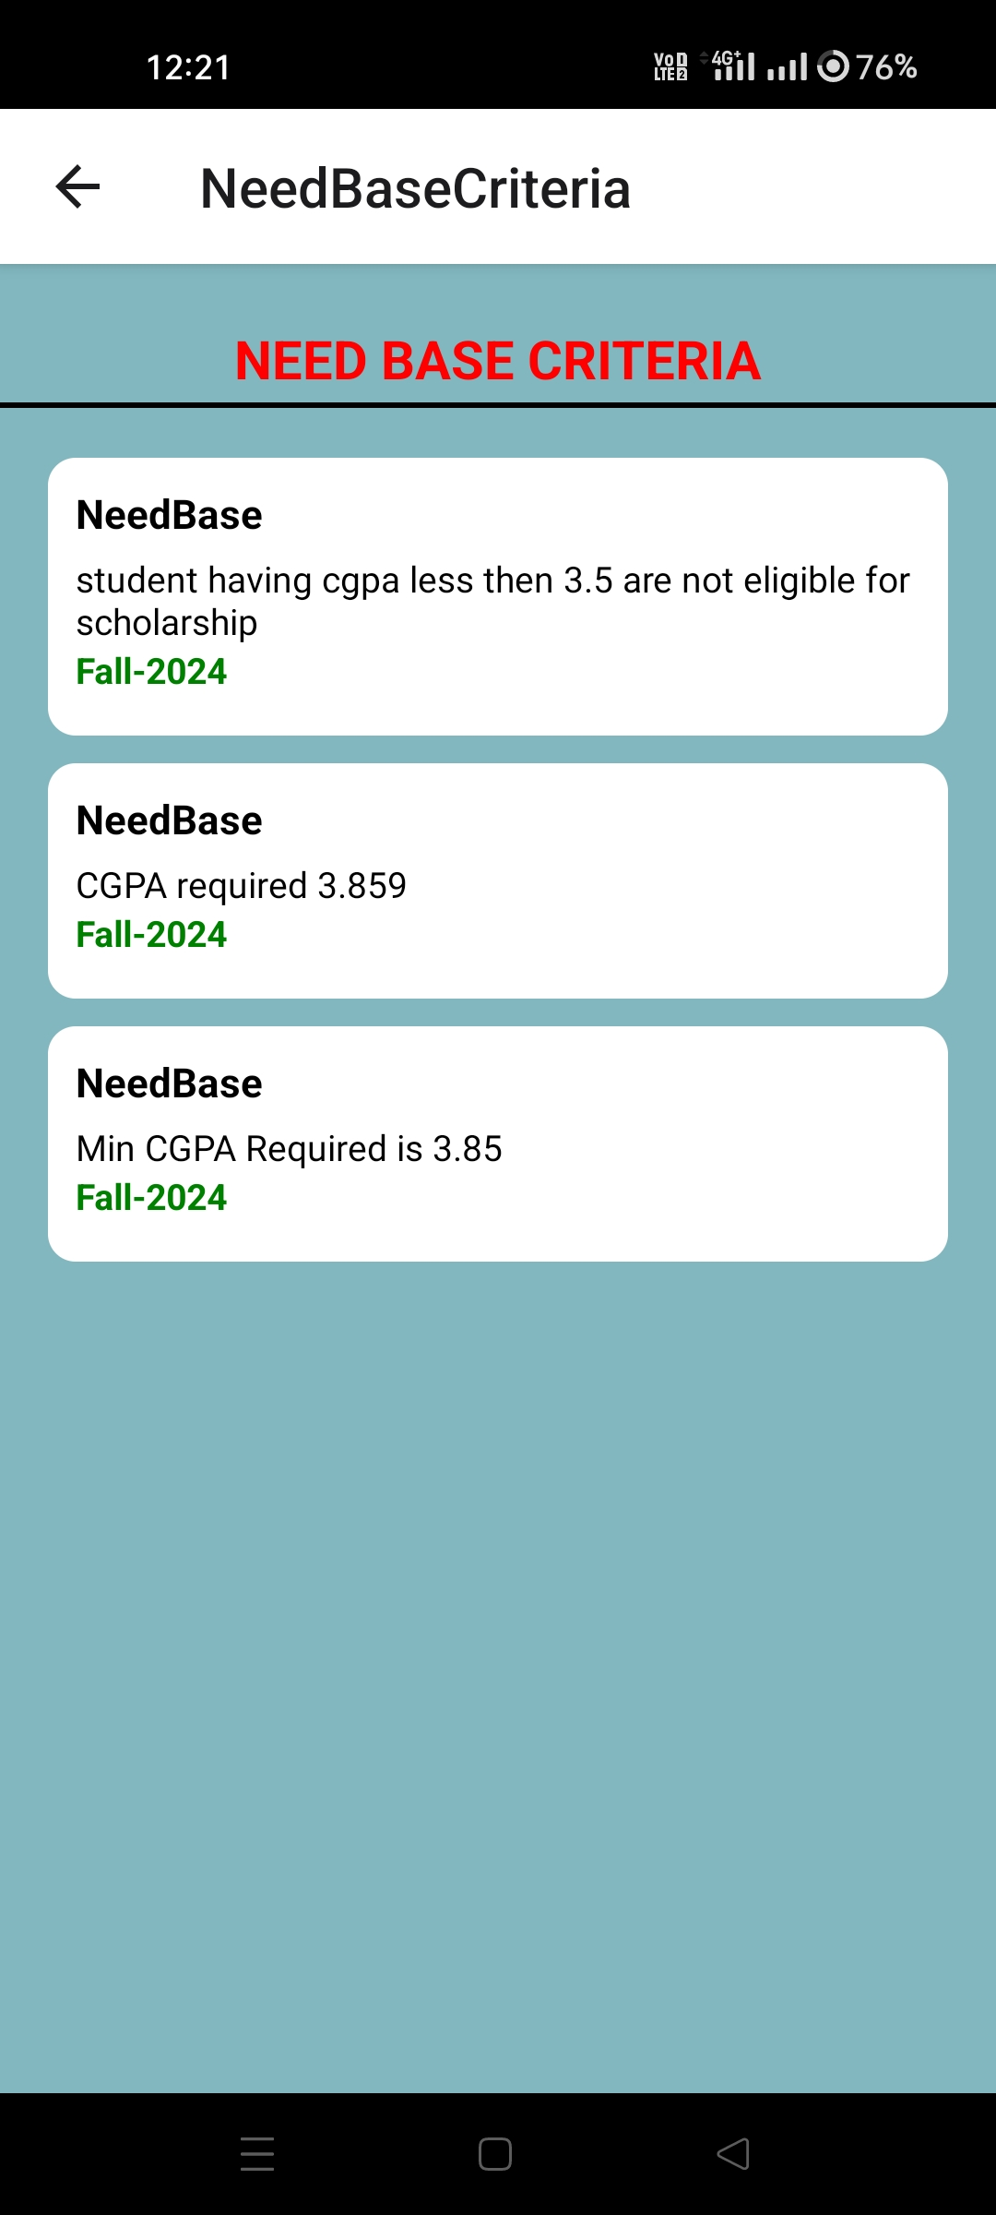
Need-base Criteria

Slide 24
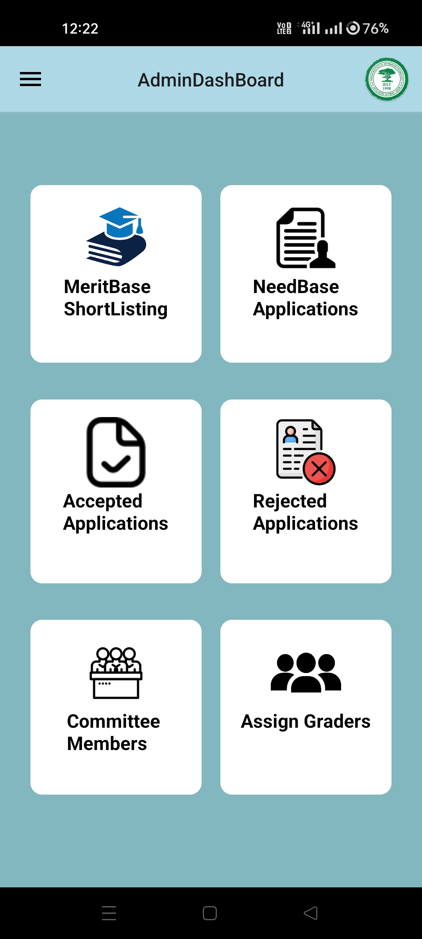
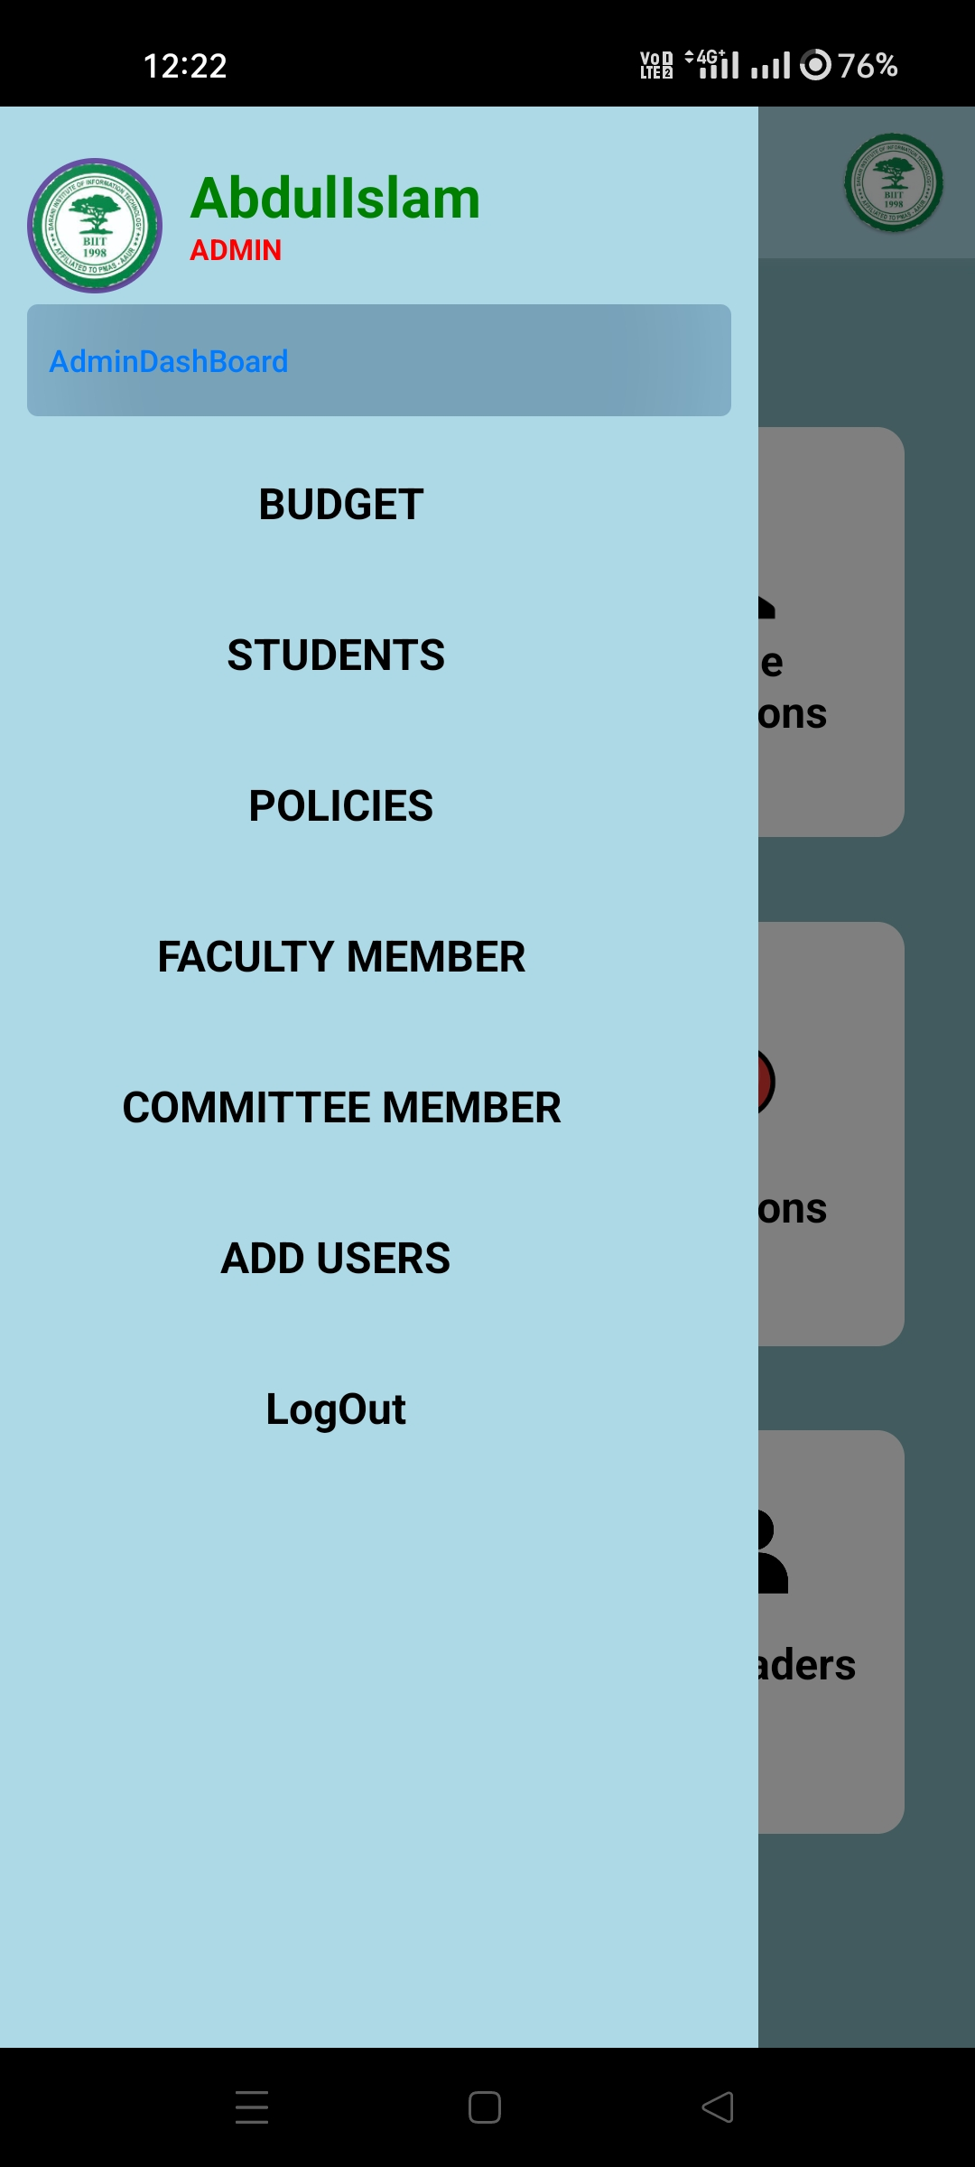
Admin Dashboard
Admin Dashboard

Slide 25
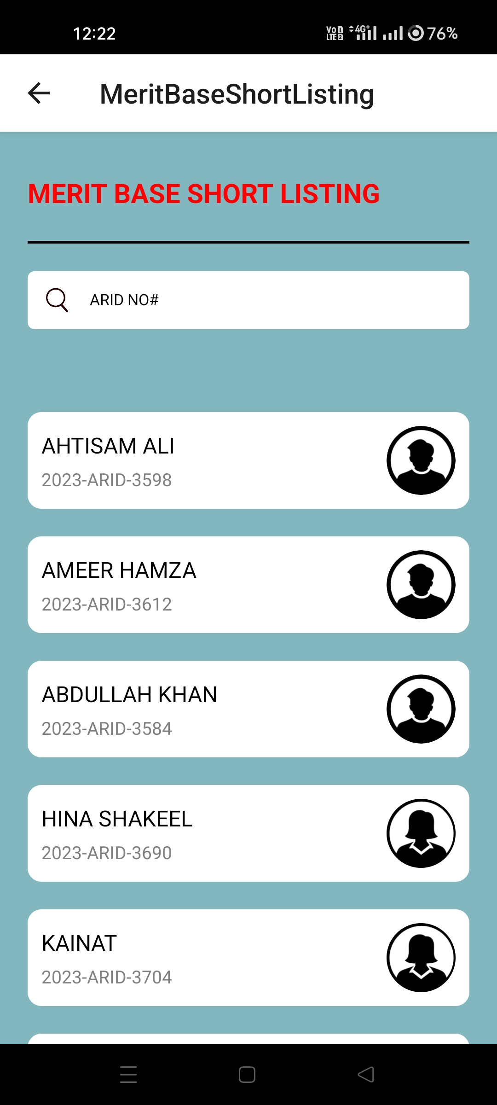
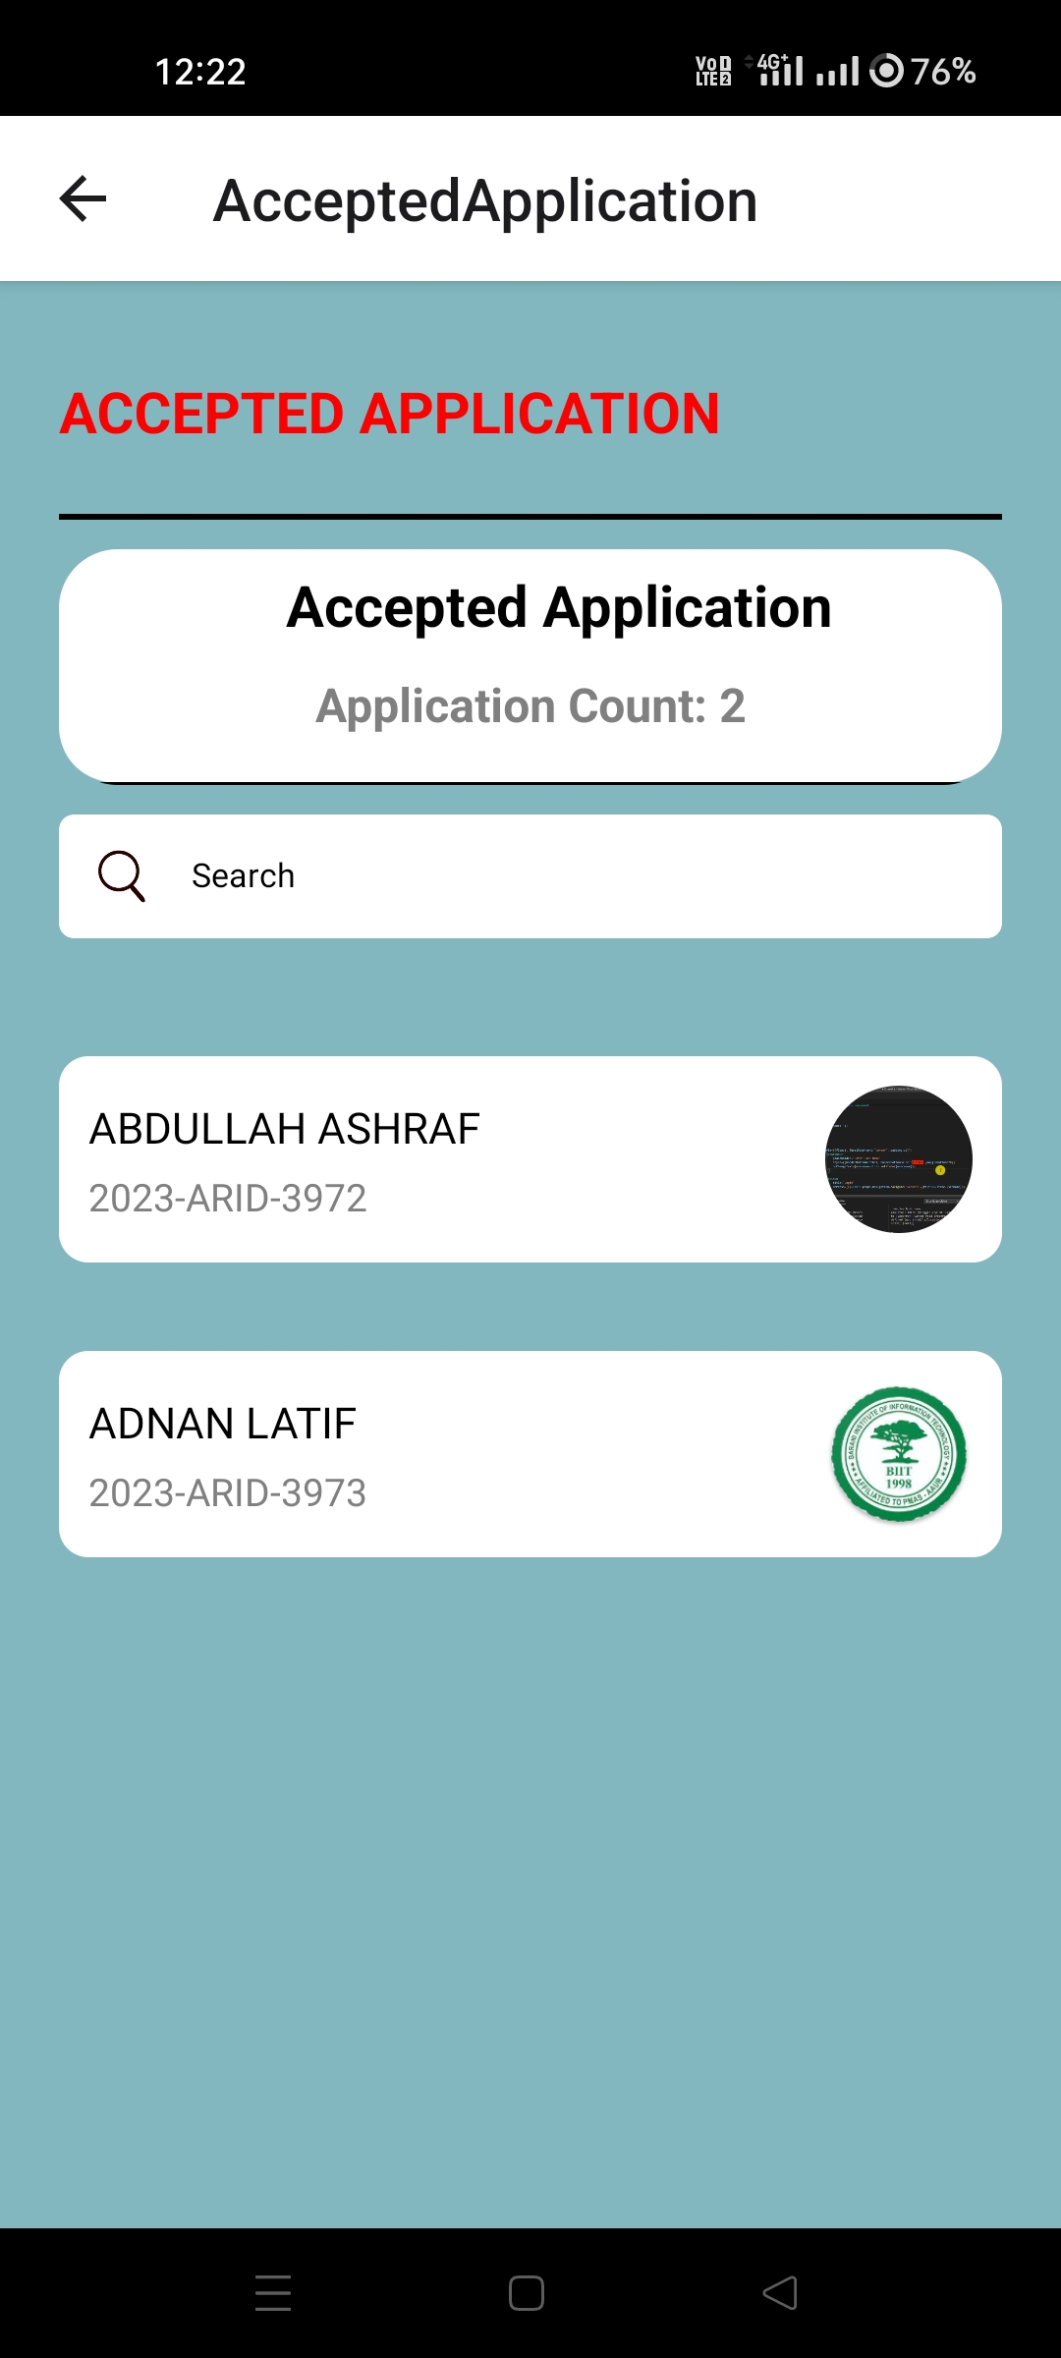
Merit-base Short-Listing
Accepted Applications

Slide 26
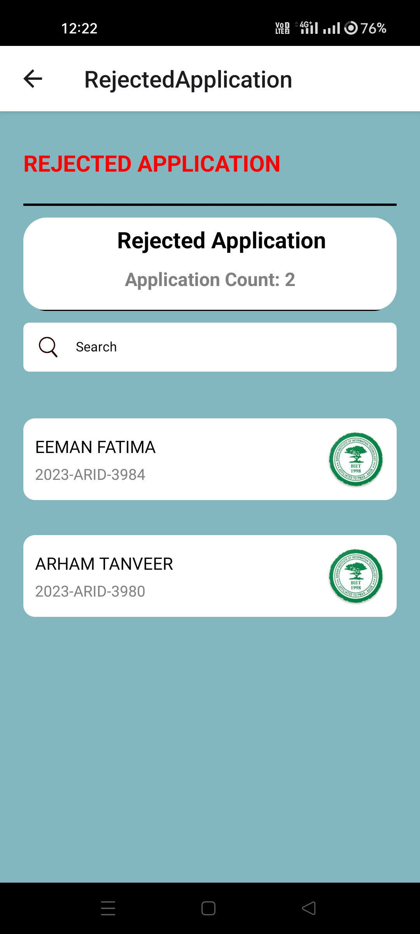
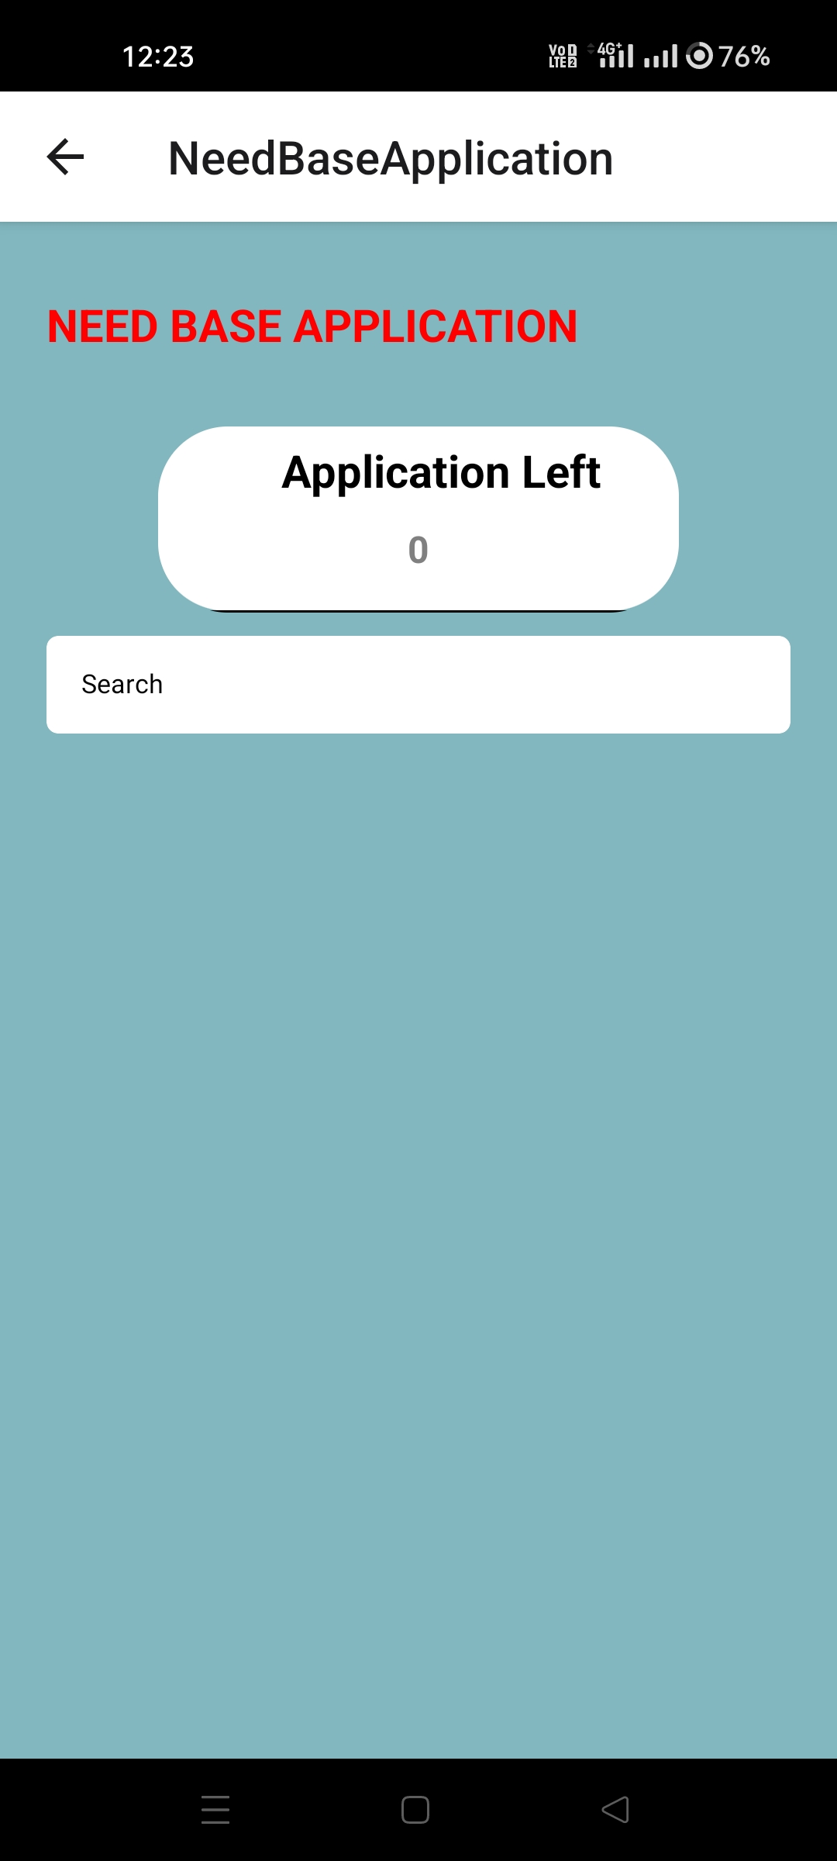
Rejected Application
Needbase Applications

Slide 27
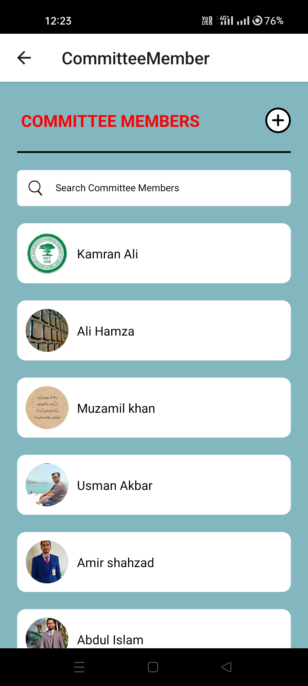

Committee Members
Add Committee Members

Slide 28


Assign Graders
Assign Faculty Member

Slide 29


Budget History
View Application

Slide 30


Policies
Add New Policy

Slide 31

Policies
Committee Dashboard

Slide 32


Committee Dashboard
View Balance

Slide 33
Android Screen’s

Slide 34


Login
Student Dashboard

Slide 35


Apply
Personal Details

Slide 36


Admin Dashboard
Admin Dashboard

Slide 37


Meritbase Short Listing
Needbase Application

Slide 38


Accepted Application
Rejected Application

Slide 39


Committee Member
Assign Graders

Slide 40


Student Records
Add Student

Slide 41


Policies
Add Meritbase Policy

Slide 42


Add Policies
Add Budget

Slide 43


Committee Dashboard
Committee Dashboard

Slide 44


Faculty Dashboard
Faculty Dashboard

Slide 45
React JS Screen’s

Slide 46

Login Screen

Slide 47

Student Dashboard

Slide 48

Apply

Slide 49

Personal Details

Slide 50

Needbase Criteria

Slide 51

Meritbase Criteria

Slide 52

Help

Slide 53

Admin Dashboard

Slide 54

Meritbase Short-Listing

Slide 55

Accepted Application

Slide 56

Rejected Applications

Slide 57

Committee Members

Slide 58

Assign Graders

Slide 59

Admin Dashboard

Slide 60

About Budget

Slide 61

Add Student

Slide 62

Policies

Slide 63

Add New Policies

Slide 64

Add Faculty Members

Slide 65

Add Committee Member

Slide 66

Allocation Sheet

Slide 67

Committee Dashboard

Slide 68

Committee View Application

Slide 69
Committee Recommendations

Slide 70

View Amount

Slide 71

Faculty Dashboard

Slide 72


